Slide 1

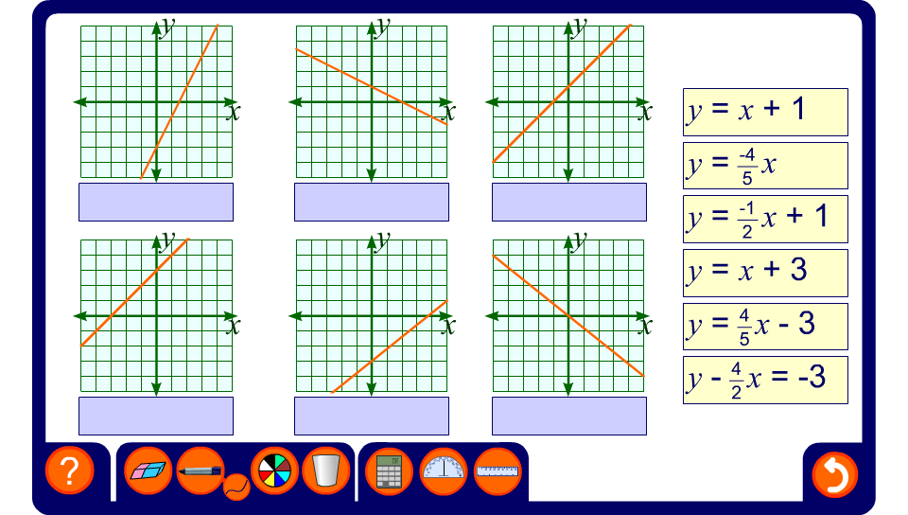


Match the equations to the graphs

